Slide 1


1248 - Style File Automation Using ArcGIS Pro, Python, and SQL
Caitlin Hartig
Xentity Corporation
Thursday, July 18, 2024
ESRI USER CONFERENCE 2024
Copyright © 2024 Esri.
All rights reserved.
Notes:
Esri Corporate Template-Dark v4.5
December 7, 2023 Copyright © 2024

Slide 2


Overview
Style File Creation Purpose and Former Workflow
Script Early Stages
Components of a Style File (.stylx)
Python Script
Constraints of Script
Load a Style File into ArcGIS Pro
Disadvantages of Using Script
Advantages of Using Script
Areas for Future Development

Slide 3


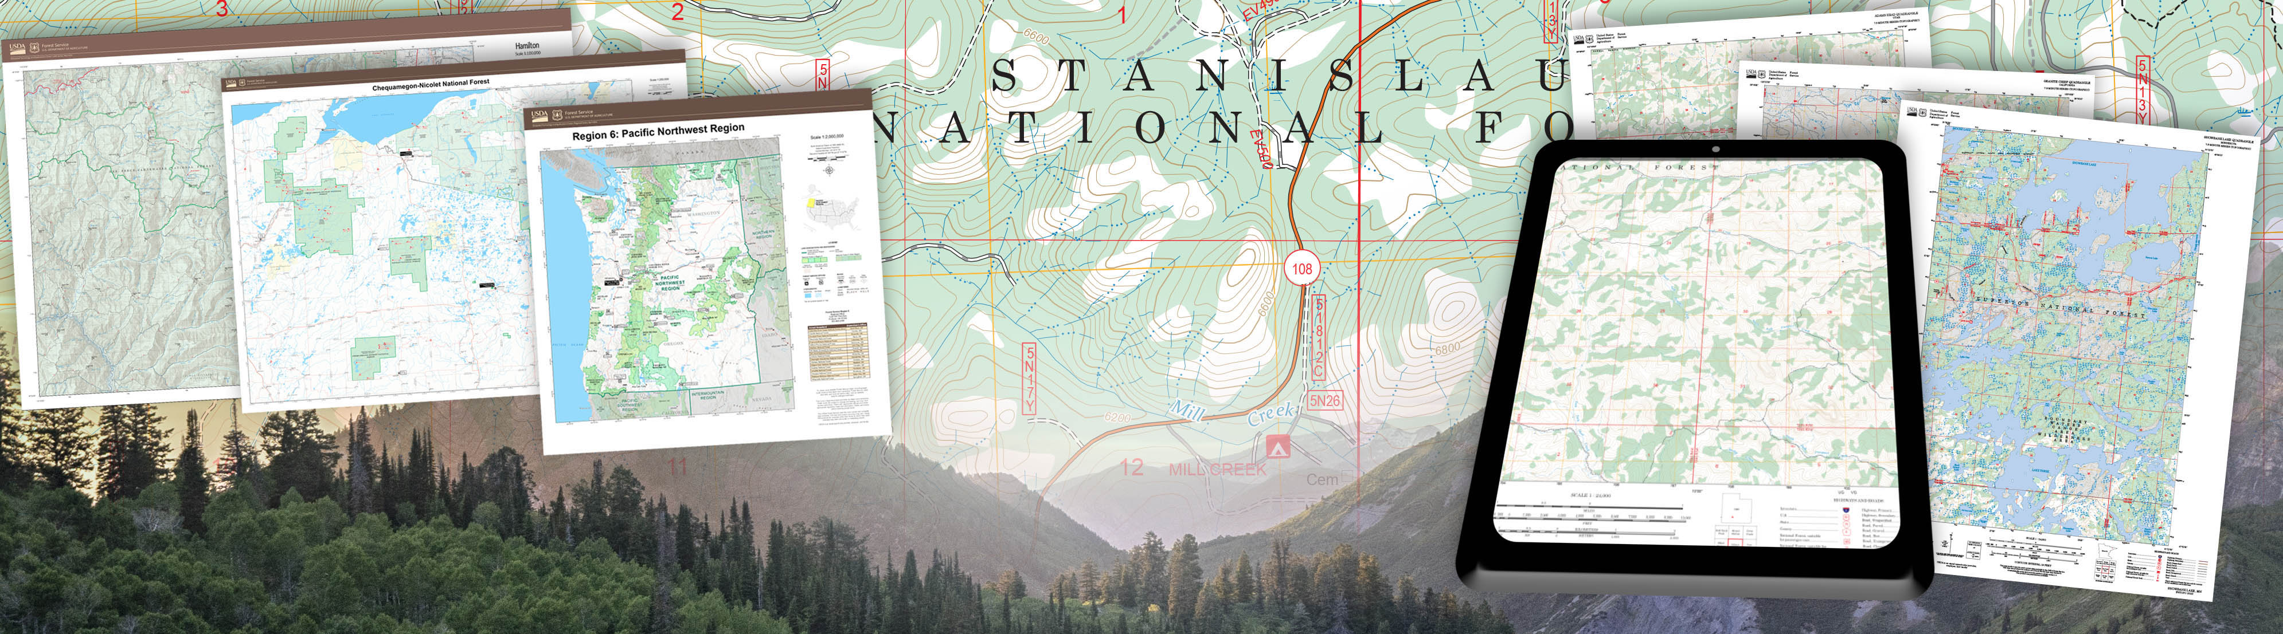

Client
USDA Forest Service: Basemap Support and Development
Forest Service Digital Maps
Production occurs 1x / year
Cover all Forest Service lands and some non-Forest Service lands
Free!

Slide 4
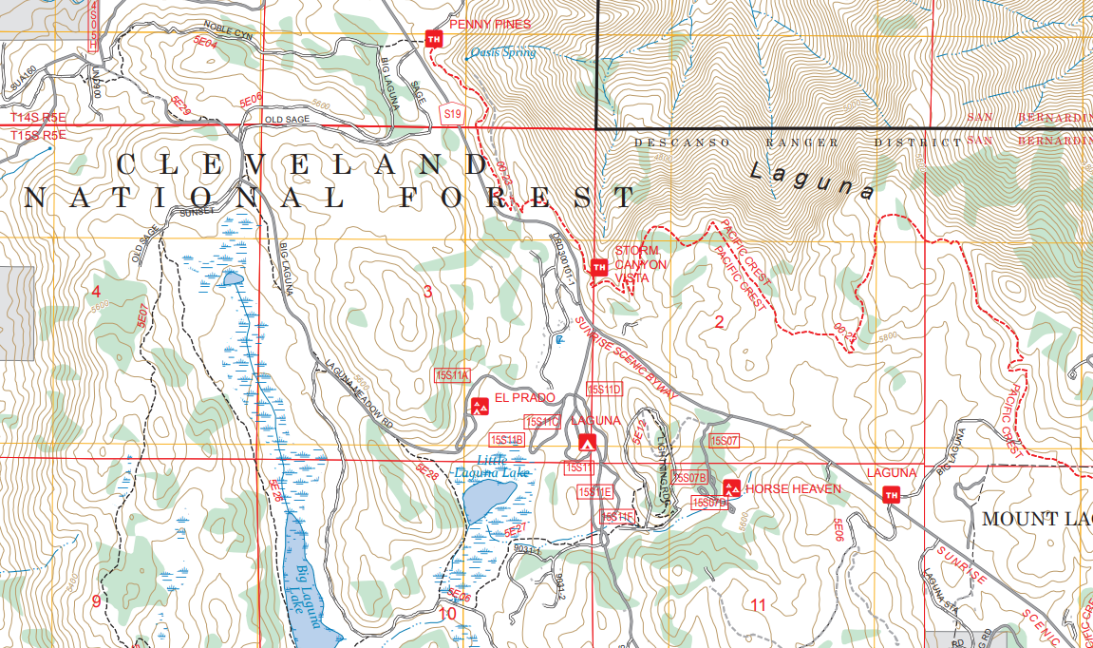
Style File Creation
USDA Forest Service: Basemap Support and Development
Need to save styles from FSTopo map series (1:24k) and 1:63k map series
Ensure style consistency among the Forest Service’s other map products
Export styles into symbology guides for final map products
Monument Peak, CA
FSTopo 2023, 1:24,000

Slide 5
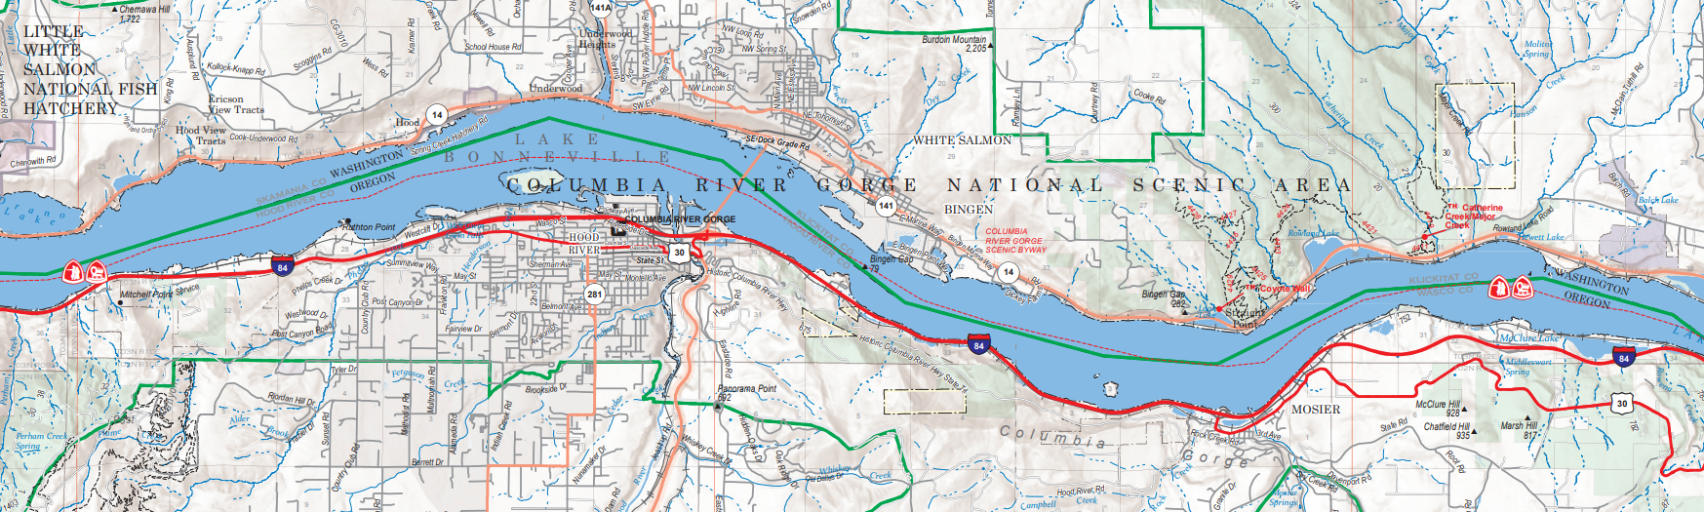
Former Style File Creation Workflow
USDA Forest Service: Basemap Support and Development
Original process involved pulling styles (40+ layers / map) manually from multiple map products at least 2x / year, if not more
Completing this workflow periodically was very time consuming!
Columbia River Gorge National Scenic Area
1:63,360 (63k) Map series

Slide 6
Script Early Stages
Currently no ArcPy tool exists to create a custom style file programmatically (maybe if there’s enough demand, they will make one!)
In-depth research showed no easy workaround
Complex approach to use Python and SQL to generate a custom style file programmatically
A style file (.stylx) is, in fact, a SQL database file!

Slide 7
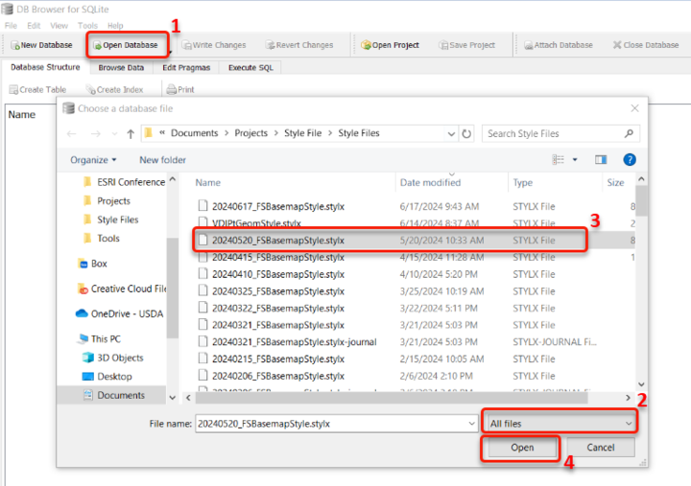
Open a .stylx with SQLite DB Browser!

Slide 8
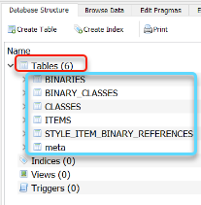
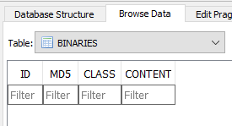
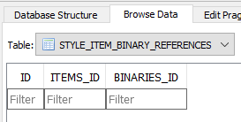
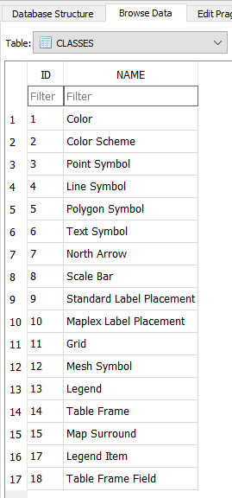
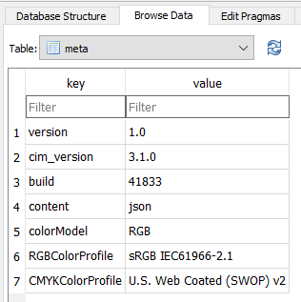
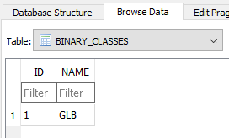
Components of a Style File (.stylx)
TABLES
BINARIES
STYLE_ITEM_BINARY_REFERENCES
CLASSES
meta
BINARY_CLASSES

Slide 9
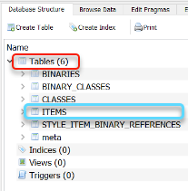
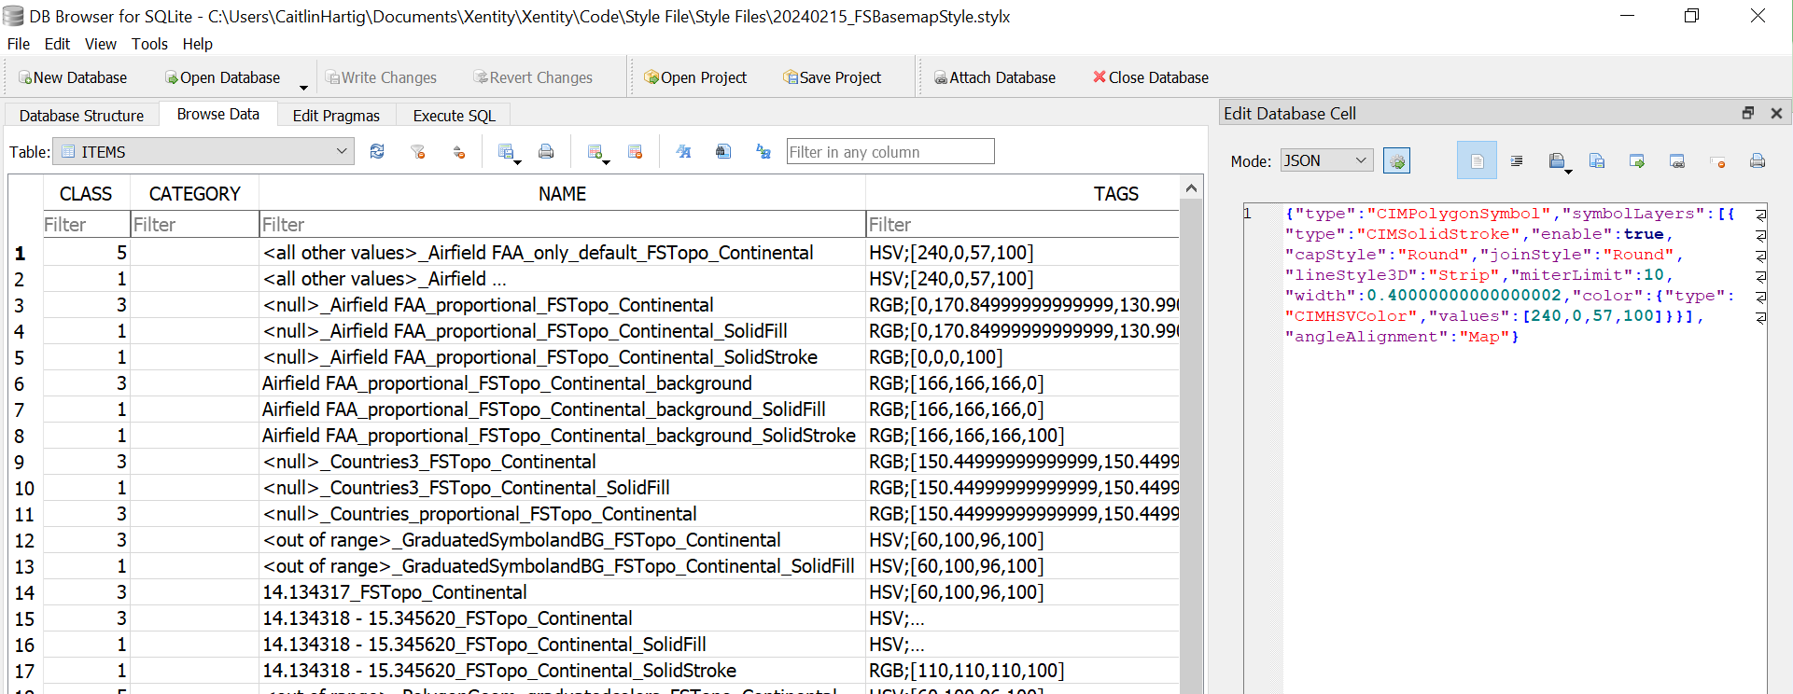
Components of a Style File (.stylx)
TABLES
ITEMS

Slide 10
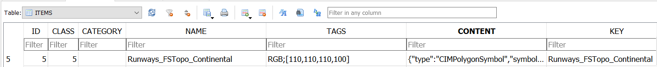
Style File ITEMS Table Schema
ID
Ex. 5
TAGS
Ex. RGB;[110,110,110,100]
Numbers the objects inside the style file
Typically starts at 1 and increases by 1
Typically contain color mode and other important information
Developed in script to include the color levels for each style
CLASS
Ex. 5
Script currently only developed for the first 5 style classes
CATEGORY
<blank>
***CONTENT***
NAME = KEY
Ex. Runways_FSTopo_Continental
Specifies the unique style constraints for each style
Name of the style as saved in the style file

Slide 11
Style File ITEMS Table JSON Format
CONTENT
Focal point of the script is to grab the content string (JSON) from the layer file (.lyrx) for each style
A working content string is a colorful content string!

Slide 12
Python Script
PROCESS OVERVIEW
Save copies of .aprx into a new folder
Pull copies of all layer files (.lyrx) from each .aprx
Note: a layer must contain a symbology renderer to save a .lyrx (or else produces an Attribute Error)
Create a new .stylx using the sqlite3 library
Insert new styles into the new .stylx using the sqlite3 library
Organize .aprx and .lyrx into folder hierarchy for future use and storage

Slide 13
Python Script
STEP 4: INSERT NEW STYLES INTO THE .STYLX
Create the BINARIES, BINARY_CLASSES, and CLASSES tables
Create the ITEMS table
Go through each .lyrx saved in the folder and pull the JSON string
Assign the ID to each style
Pull the CLASS, NAME, TAGS, CONTENT, and KEY for each style from the JSON string
Insert the symbology information into the ITEMS table
Create the STYLE_ITEM_BINARY_REFERENCES table and meta table
Save and commit the completed custom style file

Slide 14
Constraints of Script
Works for both vector and raster data
Each point, line, or polygon symbol is added as both a point, line, or polygon style, as well as a color style
For color styles, saves both the fill color and the outline color
If it exists, background color is saved for proportional symbol and graduated symbol styles
Script is set to prevent duplicate content from being added

Slide 15
Constraints of Script- Vectors
CLASS TYPE:
SUPPORTED SYMBOLOGY:
¹ Colors
² Color Schemes
³ Points
⁴ Lines
⁵ Polygons
Unique values ¹ ³ ⁴ ⁵
Graduated symbols ¹ ³ ⁴
Proportional symbols ¹ ³ ⁴ ⁵
Graduated colors ¹ ³ ⁴ ⁵
Unclassed colors ²
Bivariate ²
Dictionary ¹ ³ ⁴ ⁵
All color scheme types: Continuous, Fixed, Discrete, Random, Multipart
UNSUPPORTED SYMBOLOGY:
Dot density
Chart

Slide 16
Constraints of Script- Rasters
CLASS TYPE:
¹ Colors
² Color Schemes
³ Points
⁴ Lines
⁵ Polygons
SUPPORTED SYMBOLOGY:
Colormap ¹
Classify ¹
Unique values ¹
Stretch ²
Discrete ²
All color scheme types: Continuous, Fixed, Discrete, Random, Multipart
UNSUPPORTED SYMBOLOGY:
Vector field

Slide 17
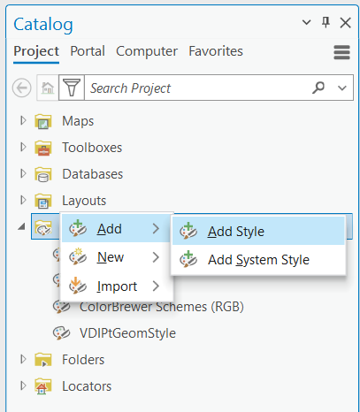
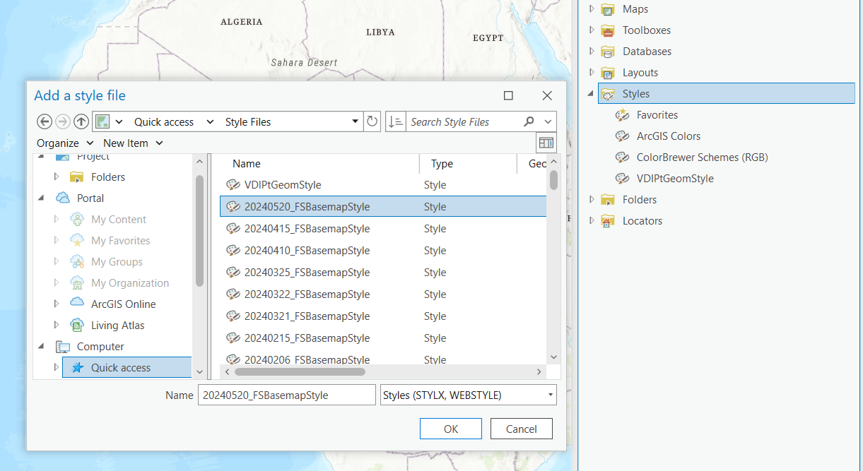
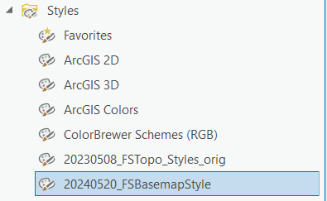
Load a Style File into ArcGIS Pro
When applying a style from your style file into a new layer, this does not automatically update the primary symbology type category in ArcGIS Pro

Slide 18
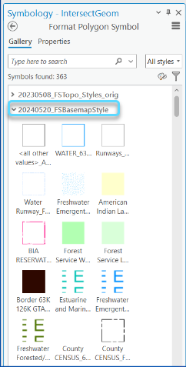
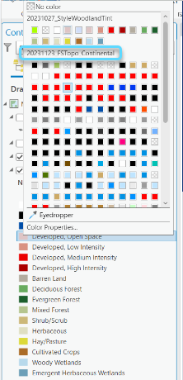
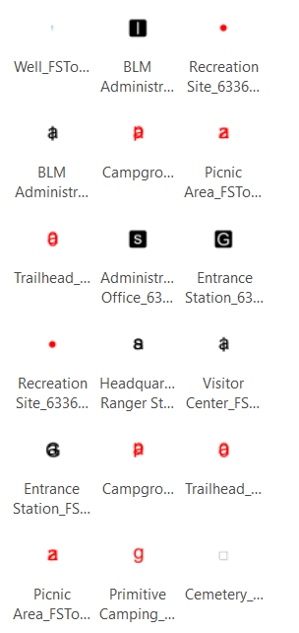
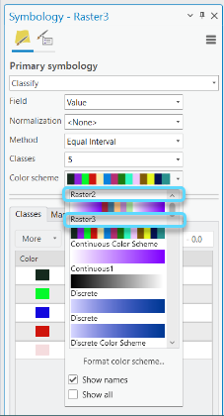
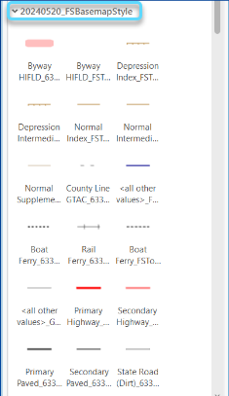
Class 2: Color Scheme
Class 4: Line
Class 1: Color
Class 3: Point
Class 5: Polygon

Slide 19
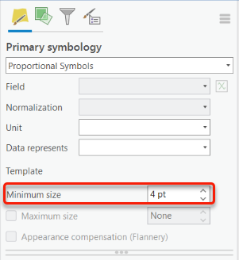
Disadvantages of Using Script over Manual Saving
Does not work for dot density, chart, or vector field symbols– differences in .lyrx output
Proportional symbols only saves 1 symbol (the “minimum size” value), even if multiple symbols are designated for the layer
Some .lyrx cannot be saved as styles because they produce a Unicode Error– likely something with how the URL is listed in the metadata

Slide 20
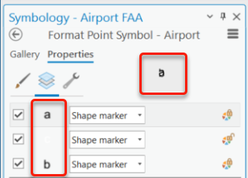
Advantages of Using Script over Manual Saving
Much more efficient
Saves time, energy, and manpower
More versatile content saving
Can save Colormap styles into a style file
Can save both the fill color and the outline color for color styles
Can save all layers of a multilayer symbol individually as a point, line, or polygon style, as well as color style
Facilitates SQL and data analysis of results
Can be used to help improve data and assist other teams
Multilayer Symbol

Slide 21
Areas for Future Development
Development for multi-layer symbols
Saving each layer in the stack individually as point, line, or polygon, as well as color
Obtain greater clarification on what causes the Unicode Error for some .lyrx
Save the contents of the .stylx into a .txt file and print the results in tabular format
Would double as a spec book for the cartography team
Develop a script to apply symbology from an existing style file into the map (script working in reverse)
Style File Script Pt 2 / Pt 3:
Development for Text Symbols
Development for Layout Elements

Slide 22


Additional Information
USDA Forest Service Website
GitHub

Slide 23
References
“Create stylx file from sketch.” Esri Community, 21 Jan. 2022, https://community.esri.com/t5/arcgis-pro-sdk-questions/create-stylx-file-from-sketch/td-p/1133903.
“Export symbology as python.” Esri Community, 08 Aug. 2023, https://community.esri.com/t5/arcgis-pro-ideas/export-symbology-as-python/idi-p/1310119.
“How to Programatically Add Symbols to a .Stylx (Styles) File and Apply That Symbology to a Feature Layer.” Esri Community, 20 Feb. 2022, community.esri.com/t5/arcgis-pro-documents/how-to-programatically-add-symbols-to-a-stylx/ta-p/921159.
“Python CIM access-ArcGIS Pro | Documentation.” Esri, 24 June 2024, https://pro.arcgis.com/en/pro-app/latest/arcpy/mapping/python-cim-access.htm.
Tilton, Thad. “Create Custom Dictionary Styles for Arcgis.” ArcGIS Blog, 30 Sept. 2020, www.esri.com/arcgis-blog/products/arcgis-pro/mapping/create-custom-dictionary-styles-for-arcgis/.

Slide 24




https://media.istockphoto.com/id/1391352876/vector/thank-you-colorful-typography-banner.jpg?s=612x612&w=0&k=20&c=jzm-E-RXHtLDQNxs_8RNe_388gbl7t7dEsYuyC0xtF8=
Geospatial Technology and Applications Center (GTAC)

Slide 25

Questions?
https://whenwomenspeak.net/wp-content/uploads/2020/03/question-mark.jpg

Slide 26

Style File Technical Appendix
https://www.spreadshirt.com/shop/design/nerdy+brain+cartoon+characters+with+glasses+sticker-D6092bcad32376c2122bb9499?sellable=ekD2oLpNk8SgnGgD3Egm-1459-215

Slide 27
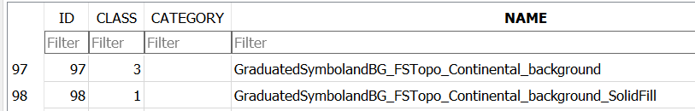
Style File ITEMS Table Name Format
NAME
Adds the sublayer name if it exists
Tacks on the umbrella layer name if there is no sublayer name or if the sublayer name is “<all other values>”
Tacks on the .aprx name
Tacks on “background” if the style is a background
Tacks on whether it is SolidStroke vs SolidFill for color styles

Slide 28
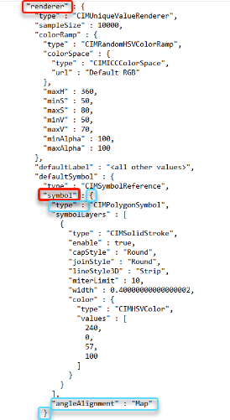
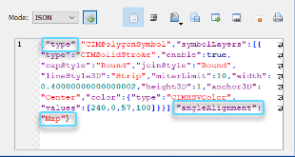
Style File ITEMS Table JSON Format
CONTENT: VECTOR
Restricts the .lyrx to the correct section (JSON string)
Differs based on the symbology type
Starts with a “{“. Key words:
“renderer” :, “symbol” :, “type” :
Ends with a “}”. Key words:
“angleAlignment” : “Display”
“angleAlignment” : “Map”
“values” :
“respectFrame” :
All spaces are removed from the JSON string
Spaces are added back into font names and URLs only

Slide 29
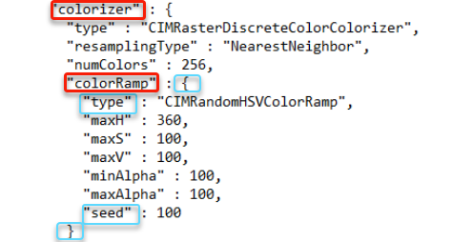
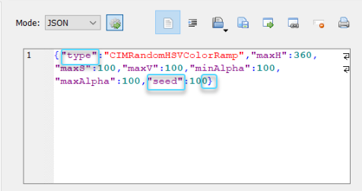
Style File ITEMS Table JSON Format
CONTENT: RASTER
Restricts the .lyrx to the correct section (JSON string)
Differs based on the symbology type.
Starts with a “{“. Key words:
“colorizer” :, “colorRamp” :, “type” :
Ends with a “}”. Key words:
“arrangement” :
“polarDirection” :
“weights” :
“seed” :
All spaces are removed from the JSON string
Spaces are added back into font names and URLs only

